Slide 1
Financial Portfolio Management System
Group 7
Anirudh Hegde Rahul Odedra
002813268 002835990
Hegde.anir@northeaster.edu Odedra.r@northeastern.edu

Slide 2
Business Problem
In the ever-evolving landscape of the financial markets, there’s a noticeable trend of more and more people jumping into the exciting world of the stock market. Existing systems often lack essential features, leading to suboptimal decision-making and portfolio management.
The problems with existing systems are:
• The amount of financial data available is making it difficult to filter relevant information and make investment decisions.
• Analysing and managing a portfolio can be a complex task and investors may struggle to balance risk and return.
• Investors often have limited time to dedicate to in-depth research and analysis.
• Identifying and managing risks associated with investments can be challenging, leading to potential losses.
• Monitoring the post-trade analytics over the time can be very difficult to manage without the right tools.

Slide 3
Business Requirements:
The business requirements of the Financial Portfolio Management System revolve around addressing the challenges faced by investors and enhancing the overall efficiency of financial portfolio management.
The key business requirements include:
The system must perform efficient fundamental and technical data analysis of companies to aid in investment decision-making.
Implement a system to suggest potential investment opportunities based on the outcomes of fundamental and technical analyses.
Implement tools for monitoring and analyzing the performance of portfolios over time.
Address the time constraints faced by investors by automating and streamlining various aspects of research and analysis.

Slide 4
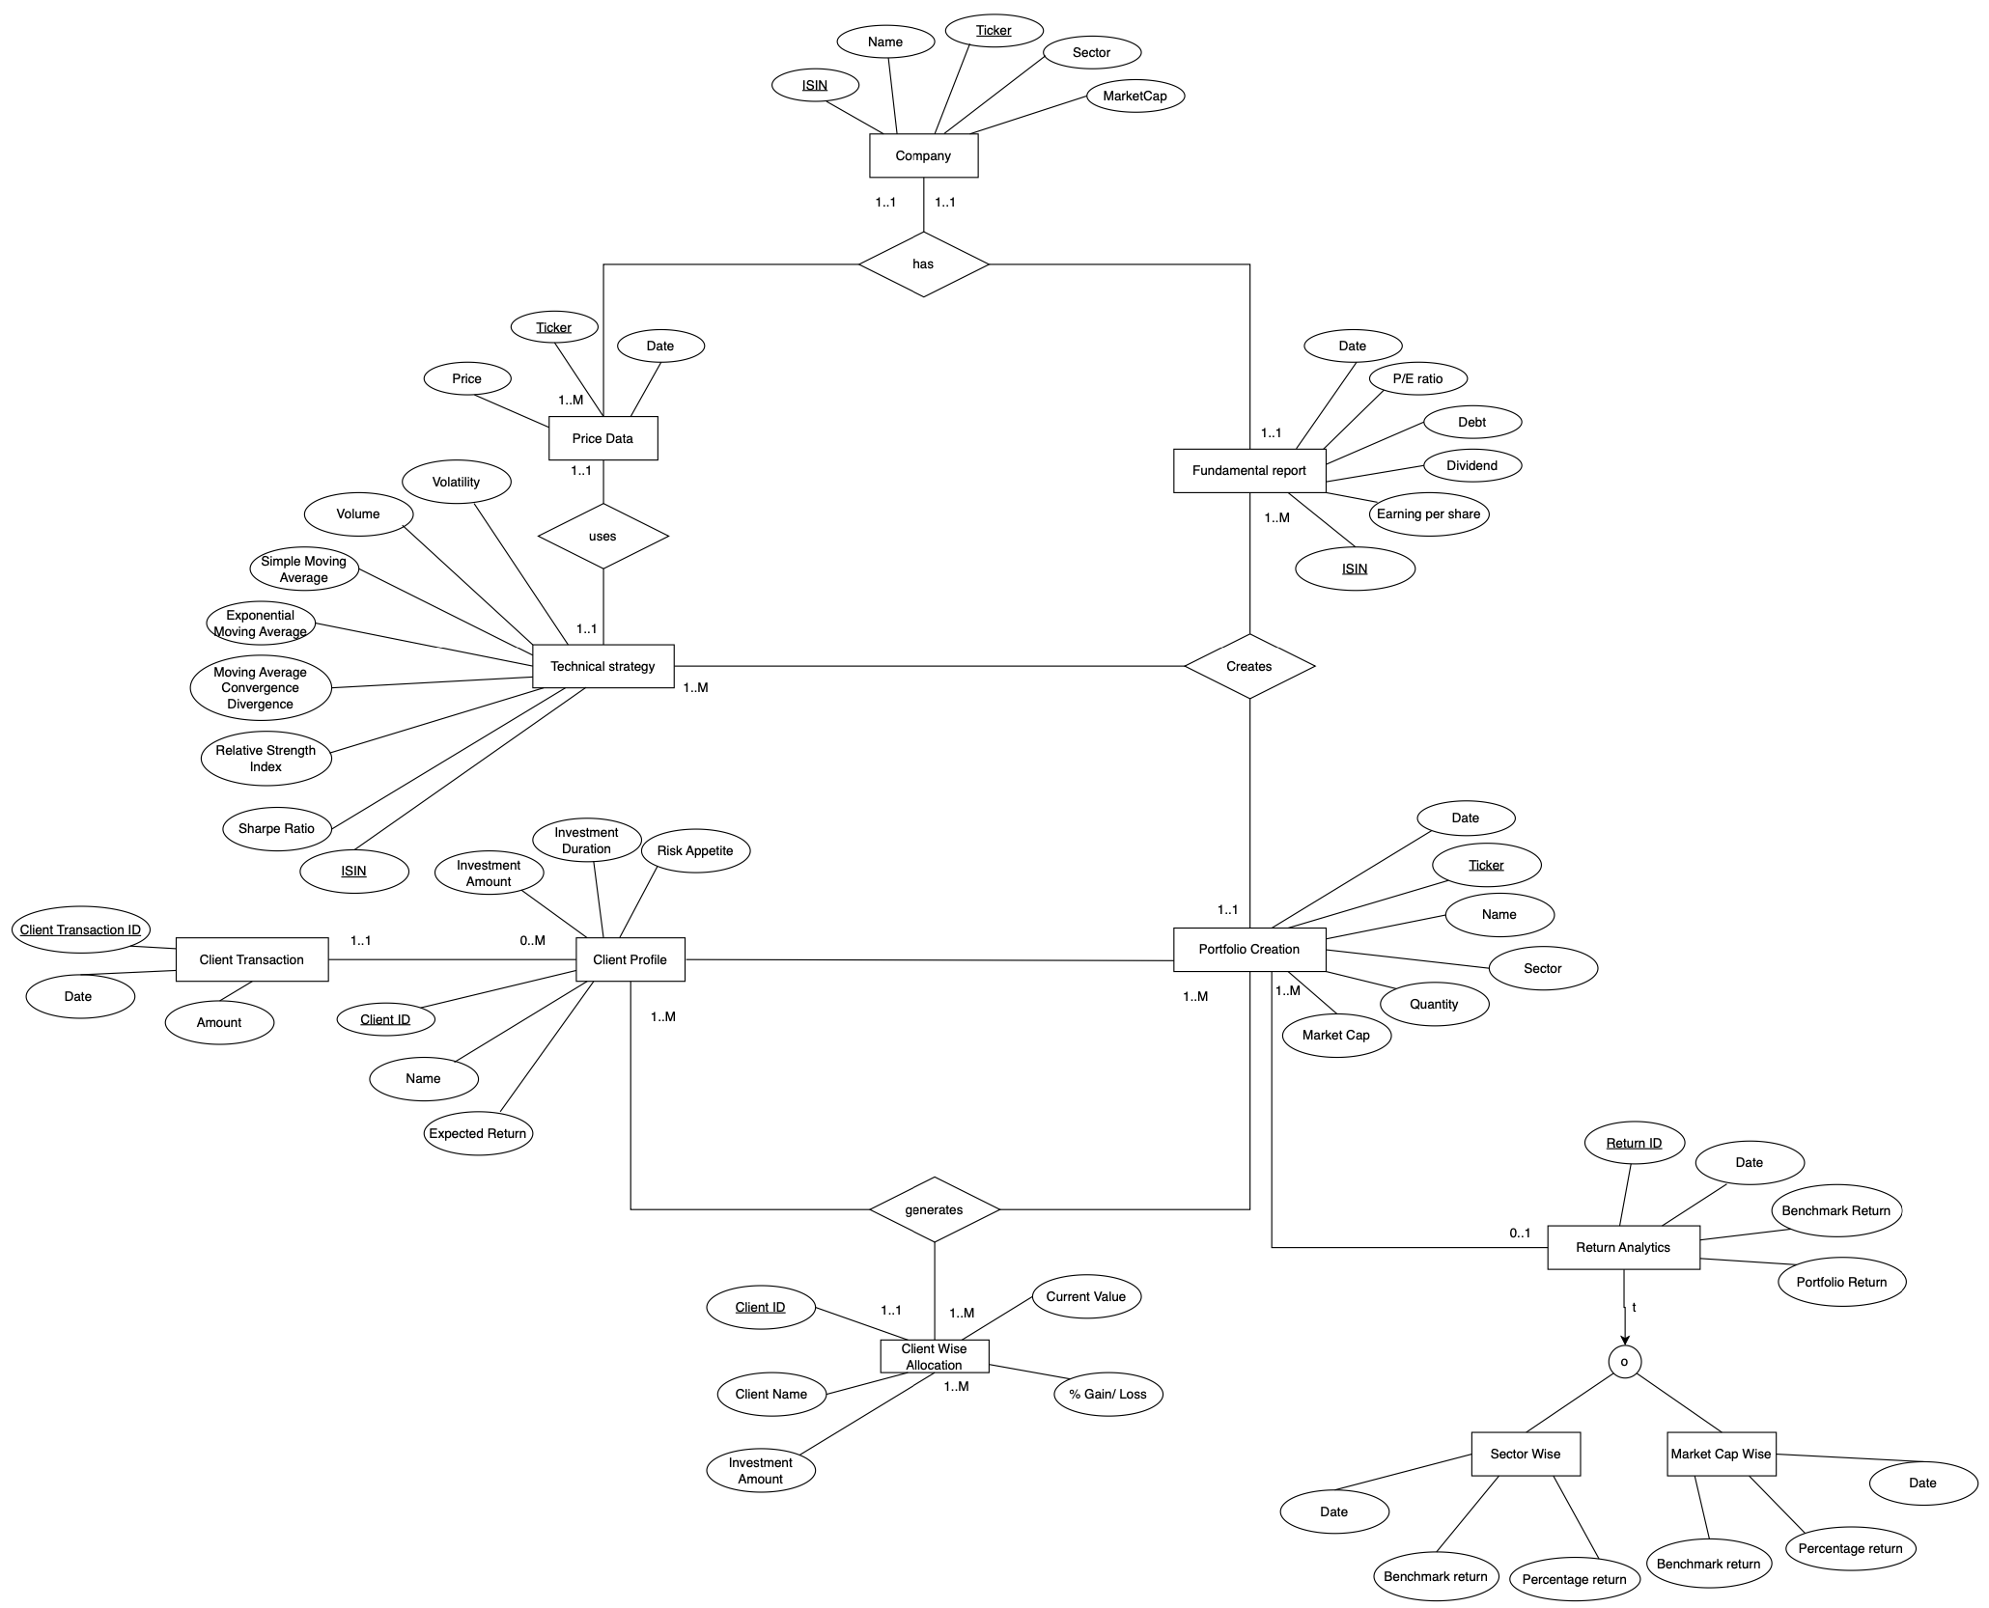
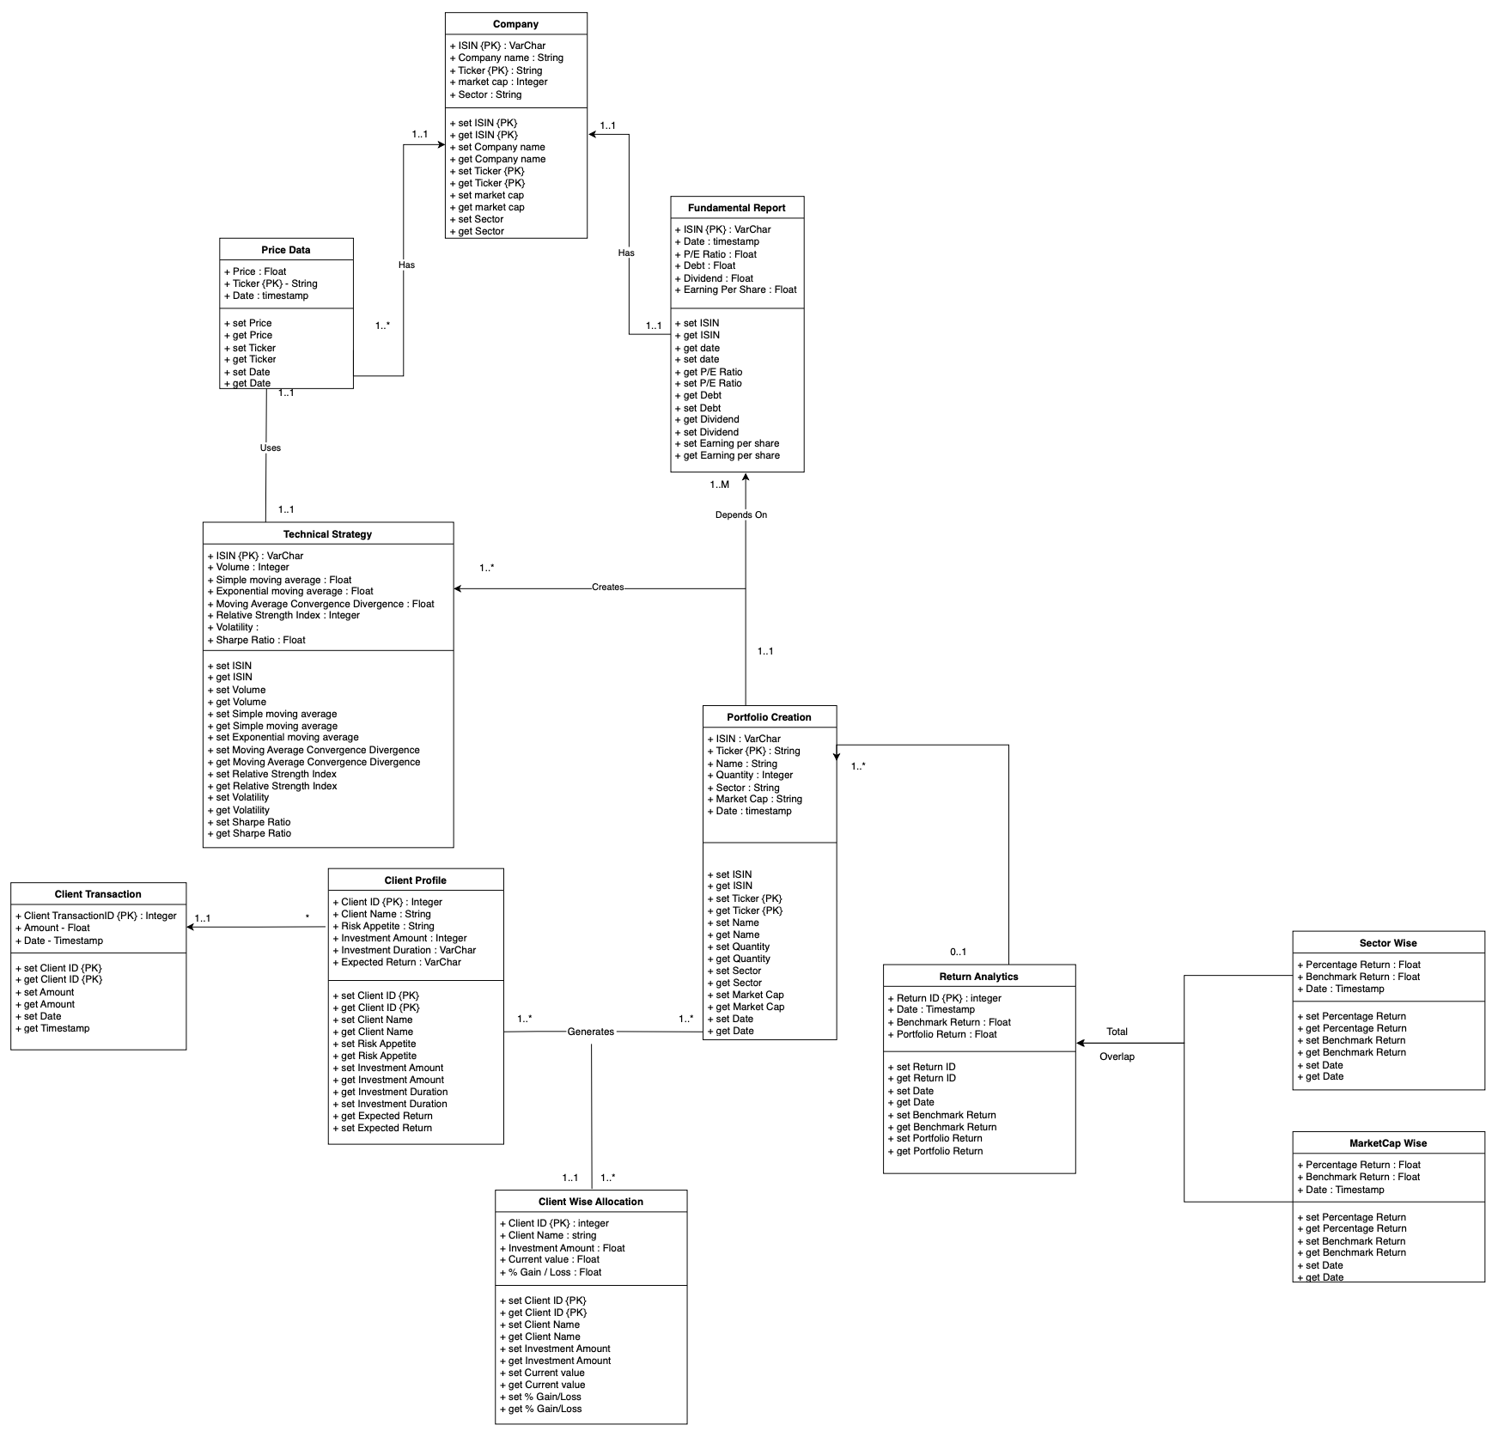
Conceptual data model (EER and/or UML)
Fig :EER Model
Fig: UML Model

Slide 5
Relational Model
Client Profile(Client ID, Client Name, Expected Return, Investment Amount, Investment Duration, Risk Appetite, Client Transaction ID)
Primary key: Client ID
Foreign key: Client ID NOT NULL, Client Transaction ID
Client Transaction(Client Transaction ID, Date, Amount)
Primary key: Client Transaction ID NOT NULL
Foreign key: -
Client Wise Allocation(Client ID, Client Name, Investment Amount, Current Value, % Gain/Loss, Date)
Primary key: Client ID
Foreign key: Client ID, Date NOT NULL
Return Analytics(Return_ID, Benchmark Return, Portfolio Return, Date)
Primary key: - Return_ID
Sector Wise(Return_ID, Sector, Benchmark Return, Portfolio Return, Date)
Primary key: Return_ID
Foreign Key : Return_ID NOT NULL
Market Cap Wise(Return_ID, MarketCap, Benchmark Return, Portfolio Return, Date)
Primary key: Return_ID
Foreign Key: Return_ID NOT NULL
Company(ISIN, Ticker, Name, Sector, Market Cap)
Primary key: (ISIN, Ticker)
Price(Ticker, Price, Date, ISIN)
Primary key: - Ticker
Foreign key: ISIN NOT NULL
Technical Strategy(ISIN, Volatility, Volume, Simple Moving Average, Exponential Moving Average, Moving Average Convergence Divergence, Relative Strength Index, Sharpe Ratio, Price, Ticker)
Primary key: ISIN
Foreign key: Ticker NOT NULL
Fundamental Report(ISIN ,Date, P/E Ratio, Debt, Dividend, Earning per share, Ticker)
Primary key: ISIN
Foreign key: ISIN, Ticker NOT NULL
Portfolio Creation(Ticker, Date, Name, Sector, Quantity, Market Cap, Return ID)
Primary key: Ticker
Foreign key: - Ticker, Return ID NOT NULL
Generates(Client ID, Ticker)
Primary key: Client ID
Foreign key: Ticker Not NULL

